Slide 1
The battle of the neighborhoods
An assessment of the vegetarian and vegan restaurant scenery in New York City

Slide 2
The vegetarian and vegan nutrition movement has been growing rapidly since the past years
For the vegan market only that is a volume of 2.22 bn USD in the US
The following analysis might be useful for tourists who just want to explore the respective food culture in Big Apple, as well as for potential restaurant owners or those who want to open a vegetarian or vegan restaurant

Slide 3

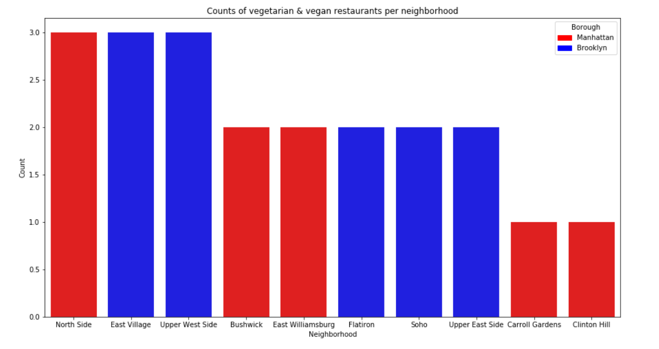
The 10 neighborhoods with the highest number of vegetarian/vegan restaurants in NCY all lay in Brooklyn and Manhatten

Slide 4
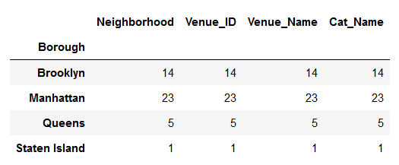
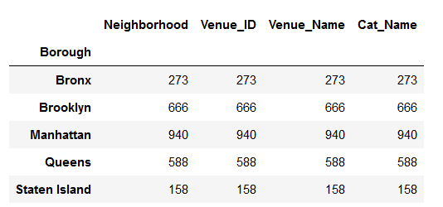
The number of vegetarian and vegan restaurants in each borough
The total number of restaurants in each borough

Slide 5
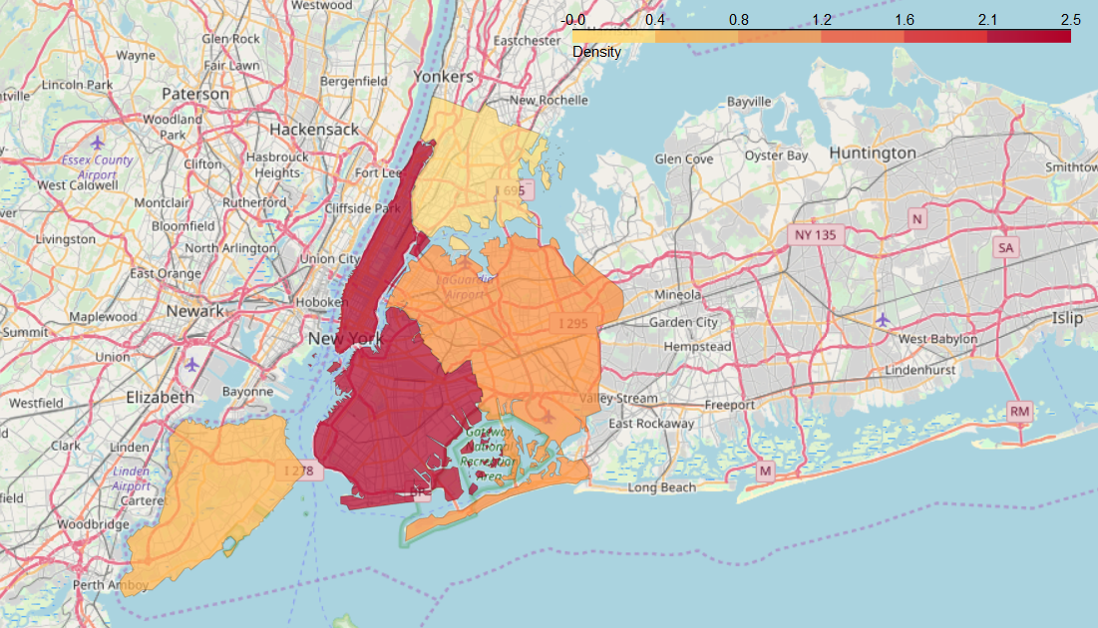
This density plot shows the percentage of vegetarian and vegan restaurants based on the total number of restaurants

Slide 6
Sources
https://www.statista.com/topics/3377/vegan-market/ https://cocl.us/new_york_dataset https://data.cityofnewyork.us/api/geospatial/tqmj-j8zm?method=export&format=GeoJSON
Link to my Github page
https://github.com/KarlFelixJoehnk/Coursera_Capstone

